Slide 1
John W. Gardner Center for Youth and Their Communities
Youth Data Archive
March 18, 2009
Physical Fitness and Academic Performance Among Redwood City Youth: Is There a Link?

Slide 2
The YDA Method
Work with community partners to identify common questions
Match cross-agency data on individual youth
Support partners to understand the resulting data analyses and their policy implications

Slide 3
Impetus for this Analysis
YDA contributors met in 2007 and identified health disparities as an important issue
YDA contributors met in June 2008 to review physical fitness preliminary results and suggest research focus

Slide 4
Findings
There is a fitness achievement gap similar to the academic achievement gap
High PFT performance is linked to high CST scores, and PFT improvements are linked CST scores gains
Overall physical fitness has a stronger link to CST scores than obesity

Slide 5

Methods Used for Analysis
Followed students across four years from Redwood City School District to SUHSD
5th grade
PFT
7th grade
PFT
4th grade 6th grade
CST CST CST CST
Year 1 Year 2 Year 3 Year 4
6th grade 7th grade 8th grade 9th grade
PFT PFT
CST CST CST CST

Slide 6
Methods Used for Analysis
Divided students into four groups based on PFT performance:
  Pass→Pass
  Fail→Pass
  Pass→Fail
  Fail→Fail
    Pass = Passing 5 out of 6 PFT measures
Examined CST score trajectories over time among the four PFT groups

Slide 7
Finding 1: Fitness achievement gap is similar to academic achievement gap
Factors associated with lower academic scores are also associated with lower fitness scores:
  Ethnicity
  Free/Reduced Lunch
  English Language Proficiency
  Parental Education Level

Slide 8
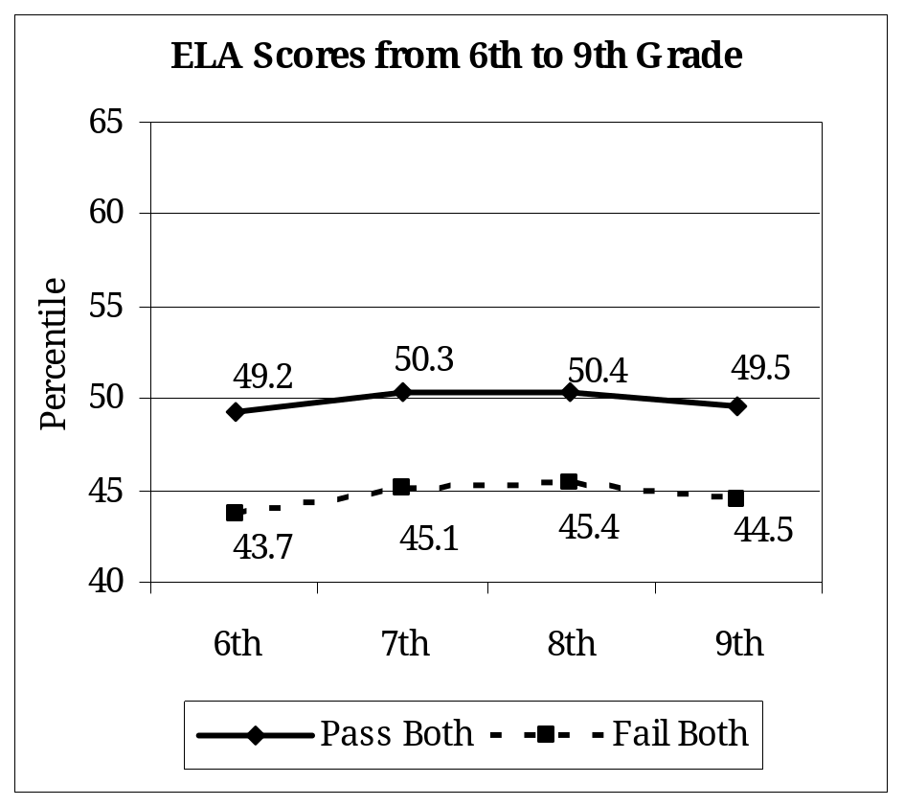
Finding 2: High PFT performance is linked to high CST scores, and PFT improvements are linked to CST scores gains
Passing the PFT both times is linked to higher Math and ELA scores.
PFT improvements are linked to higher CST scores, particularly among younger students

Slide 9
Finding 3: Overall physical fitness has a stronger link to CST scores than obesity
Body Mass Index (BMI) = Weight ÷ Height
About 20% of overweight students are physically fit (pass 5 out of 6 PFT measures)
Little difference in CST scores based on BMI alone - overall fitness has a stronger link

Slide 10
What can we learn from this?
Findings do NOT imply causality
Students who are physically fit do better academically than unfit students
Reasons for this link from other research:
  Physical activity helps concentration
  Fitness is related to higher self-esteem

Slide 11
Policy and programmatic implications
Maximizing in-school opportunities to improve fitness
  Physical education and athletic programs
  Food options at schools
  Media messaging education
Partnerships with organizations that provide health and fitness opportunities to schools
Family outreach and education on fitness and nutrition

Slide 12
Next Steps
Study of SUHSD and RCSD student participation in Parks and Rec activities
  Possible focus on Latino youth for pending Robert Wood Johnson Foundation grant
Analysis of the connection between physical fitness and mental health

